Slide 1
Big Data challenges for the e-Mobility
PIP2001 Capstone Project
Review-0
Project Statement: PSCS-103
Under the Supervision of,
Dr. Joseph Michael Jerard V
Professor
School of Computer Science and Engineering
Presidency University
Roll Number | Student Name
20211CSE0468 | Godugu Akshay Kumar
20211CSE0837 | Mohammad Fayaz
20211CSE0479 | Malleboina Lokesh Yadav
Name of the Program: B.Tech Computer Science and Engineering
Name of the HoD: Dr. Asif Mohammad
Name of the Program Project Coordinator: Prof. Srinivas Mishra
Name of the School Project Coordinators: Dr. Sampath A K / Dr. Abdul Khadar A / Mr. Md Ziaur Rahman

Slide 2
Content
Abstract
Objectives
Proposed Method
Existing Methods-Drawbacks
Architecture Diagram
Hardware and Software Requirements
Time Line Gantt Chart

Slide 3
Problem Statement Number: PSCS103
Organization: ABB GIS Pvt Ltd
Category (Hardware / Software / Both) : Software
Problem Description: An EV user must be assured that power will be available when needed especially in an unfamiliar area. A route optimization approach based on Machine Learning needs to be considered to ensure that vehicle drivers are led to the nearest or their preferred e-Station.
Technology Budget: Smart Vehicles
Difficulty Level: Simple

Slide 4
Abstract
Electric vehicle (EV) users require reliable access to power, particularly when navigating unfamiliar areas. Ensuring the availability of charging stations is crucial to avoid range anxiety and enhance the overall user experience. This project proposes a route optimization approach leveraging machine learning to guide EV drivers to the nearest or their preferred charging stations. By analyzing real-time data, including vehicle status, traffic conditions, and charging station availability, the system can predict the optimal route for efficient and timely charging. This solution aims to increase user confidence in EVs, promote broader adoption, and contribute to the development of a more robust e-mobility infrastructure.

Slide 5
Objectives
1.Ensure Availability of Charging Stations:
Objective: Develop a system that guarantees EV users will have access to charging stations whenever needed, even in unfamiliar areas.
Implement Route Optimization with Machine Learning:
Objective: Design and implement a machine learning-based route optimization algorithm.
Real-Time Data Integration:
Objective: Integrate real-time data from various sources (e.g., charging station status, traffic conditions) into the route optimization algorithm.
Preference-Based Routing:
Objective: Allow users to set preferences for certain charging stations based on factors such as charging speed, cost, or amenities.
Minimize Travel and Charging Time:
Objective: Optimize routes to minimize both travel time to charging stations and charging time itself.
Safety and Reliability:
Objective: Ensure the safety and reliability of the route recommendations, taking into account factors such as road conditions and weather.

Slide 6
Proposed Method
1.Data Collection
2.Data Preprocessing
3.Machine Learning Model Development
4.Route Optimization Algorithm
5.Real-Time Recommendations
6.User Interface
7.Testing and Deployment
8.Evaluation and Improvement

Slide 7
Existing Methods-Drawbacks
Existing Methods
Static Charging Station Maps:
Description: Static maps provide the locations of charging stations without real-time data. They may be available through online maps or printed guides.
Drawbacks:
No real-time availability information.
No integration with the vehicle’s current state or route.
Lack of user preference considerations (e.g., preferred charging network).
Navigation Systems with Charging Station Integration:
Description: Some GPS navigation systems include charging stations in their databases and can provide routing to these stations.
Drawbacks:
Often do not account for real-time data such as station availability or current occupancy.
Limited to pre-set databases, which might not be updated frequently.
Lack of advanced features like prediction of future availability or user preferences.

Slide 8
Existing Methods-Drawbacks
Drawbacks Addressed by Machine Learning-Based Route Optimization
Dynamic Data Handling:
Machine Learning (ML) Advantage: ML algorithms can process real-time data from various sources (e.g., current charging station availability, traffic conditions) to dynamically adjust routes.
Drawback Addressed: Overcomes the static nature of traditional methods, ensuring users have the most up-to-date information.
Predictive Analytics:
ML Advantage: Predictive models can forecast charging station availability based on historical data, usage patterns, and current trends.
Drawback Addressed: Helps in avoiding situations where a charging station is predicted to be occupied upon arrival.
User Preference Integration:
ML Advantage: Personalization algorithms can learn user preferences (e.g., preferred charging networks, station amenities) and incorporate these into route planning.
Drawback Addressed: Provides a tailored experience that static systems and non-personalized apps cannot offer.

Slide 9
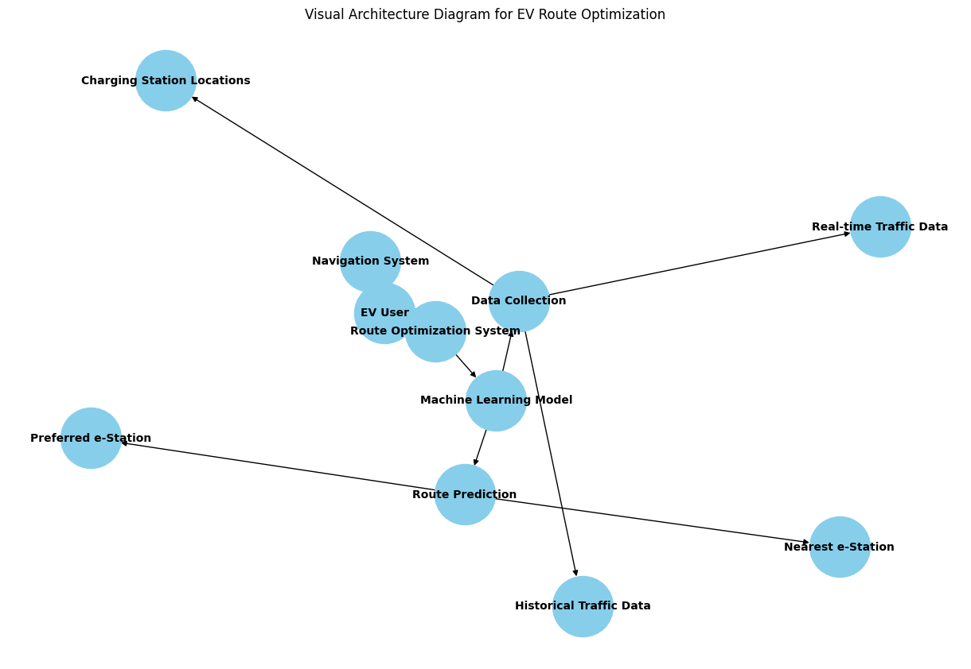
Architecture Diagram

Slide 10
Software and Hardware Requirements
Software Requirements:
Machine Learning Algorithms
Data Integration and Processing
Real-Time Data Analytics
User Interface and Experience
APIs and Middleware
Security and Privacy
Hardware Requirements:
On-Board Units (OBUs)
Charging Stations
Data Centers/Cloud Infrastructure
Mobile Devices

Slide 11
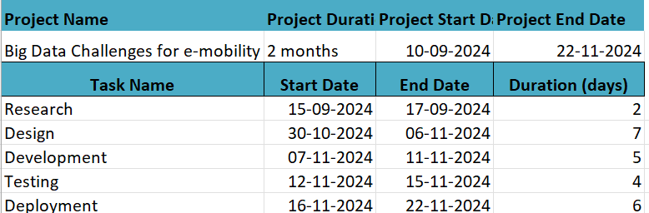
Timeline by Gantt Chart

Slide 12
Github
Upload files · project-pscs103/Capstone-Project

Slide 13
References
1.N. Nagel, ‘‘Actuation challenges in the more electric aircraft: Overcoming hurdles in the electrification of actuation systems,’’ IEEE Electrific. Mag., vol. 5, no. 4, pp. 38–45, Dec. 2017.
2.Z. Jin, G. Sulligoi, R. Cuzner, L. Meng, J. C. Vasquez, and J. M. Guerrero, ‘‘Next-generation shipboard DC power system: Introduction smart grid and DC microgrid technologies into maritime electrical networks,’’ IEEE Electrific. Mag., vol. 4, no. 2, pp. 45–57, Jun. 2016.
3.R. Dhaouadi and M. A. Sleiman, ‘‘Development of a modular mobile robot platform: Applications in motion-control education,’’ IEEE Ind. Electron. Mag., vol. 5, no. 4, pp. 35–45, Dec. 2011.
4.All-Electric Vehicles. [Online]. Available: https://www.fueleconomy.gov/ feg/evtech.shtml#end-notes

Slide 14


